Slide 1
Naturalist badge
By Cleo

Slide 2
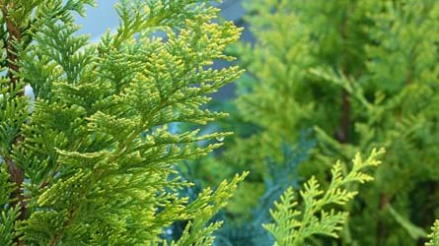
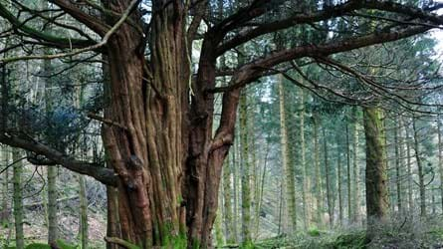
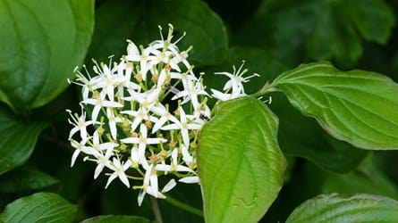
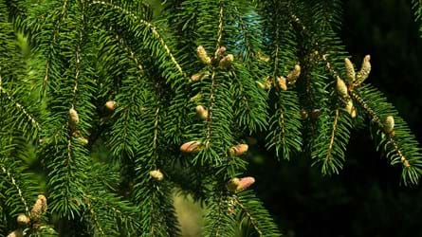
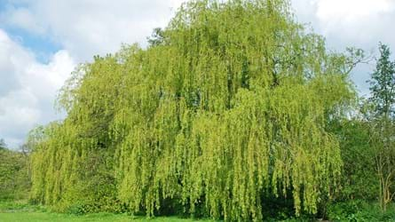
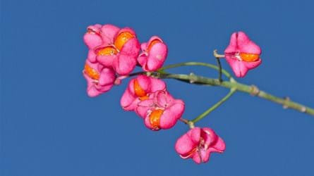
6 trees woodland trust website
Lawson Cypress
Yew
The yew is one of the longest-lived native species in Europe. This has made it a symbol of death , but it provides food and shelter for woodland animals, like woodpeckers. Has poisonous red berries.
Tall furry plant, one of UK’s most popular garden plant . It has a hot resistant wood which is popular in Japan for coffins and shrines.
Dogwood
Norway Spruce
Understated until the colder months when it bursts into colour . The timber is SO hard it can be used for crucifixes.
Festive, useful, squirrel food.
Made popular by Prince Albert, Norway spruce is a familiar non-native, with friendly winter colour and a value to native wildlife. It is also used for Christmas trees.
Willow
Spindle
Huge, sweeping and romantic, the white willow is a typical weeping willow. Spot it at riversides with leaves draped in the water where it feeds and shelters native wildlife.
Delicate, colourful. The spindle is at its loveliest in autumn when its leaves turn russet and its pink and orange fruits ripen. Wildlife loves its leaves and fruit

Slide 3
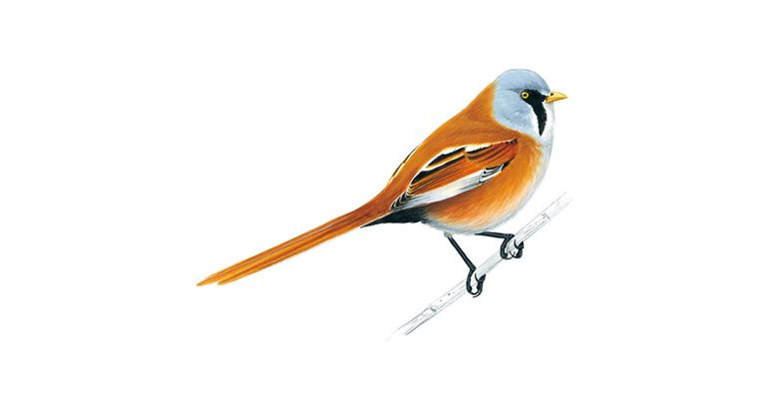
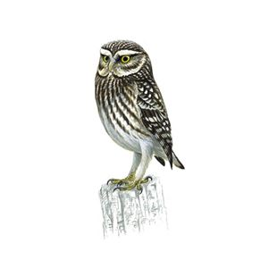
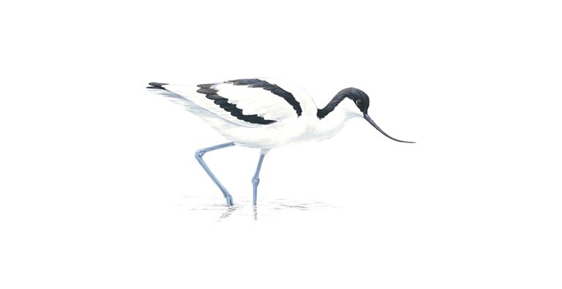
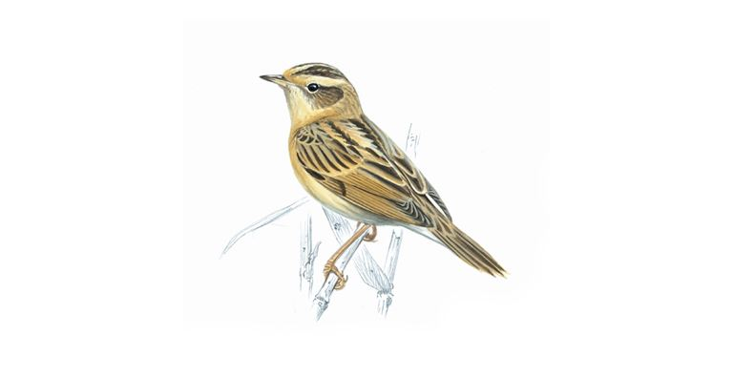
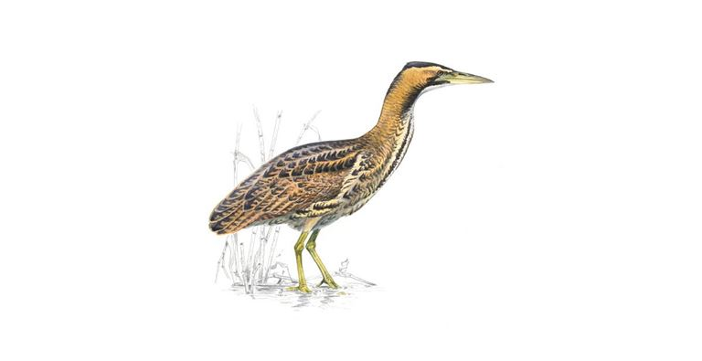
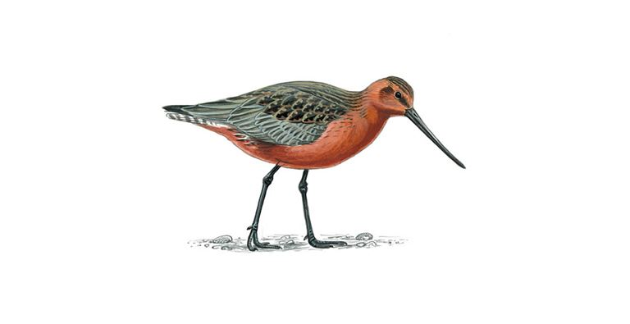
6 birds rspb website
Bearded tit
The bearded tit is a Schedule 1 species. They are brown, long-tailed birds, usually seen flying rapidly across the top of a reedbed. Males have black 'moustaches' rather than 'beards'.
Little owl
It can be seen in the daylight, usually perching on a tree branch, telegraph pole or rock. It will bob its head up and down when alarmed. In flight it has long, rounded wings, rapid wingbeats and flies.
The avocet is a distinctively-patterned black and white wader with a long up-curved beak.
Avocet
they eat Aquatic insects and their larvae, crustaceans and worms.
Aquatic warbler
The aquatic warbler is a regular but scarce autumn migrant to certain areas in southern Britain, visiting on its way between breeding grounds in eastern Europe and its winter home in West Africa.
The colour , yellow-brown and streaked than the similar sedge warbler with a distinct yellow crown stripe.
Bittern
The bittern is a thickset heron with all-over bright, pale, buffy-brown plumage covered with dark streaks and bars. It flies on broad, rounded, bowed wings. A secretive bird, very difficult to see, as it moves silently through reeds at water's edge, looking for fish.
Bar-tailed godwit
The bar-tailed godwit is a long-billed, long-legged wading bird which visits UK shores for the winter. Most usually seen in its grey-brown winter plumage, birds in spring may show their full rich chestnut breeding plumage. In flight it shows a white patch stretching from the rump up the back, narrowing to a point.

Slide 4
6 wild flowers wildlife trusts website
Ven violet
Chiltern gentian
Bluebell
Considered to be one of the prettiest gentians, the Chiltern gentian is a rare plant that is only found in the UK. It likes chalk grasslands, its purple, trumpet-shaped flowers blooming from August.
A pale member of the violet family sometimes known as ‘milk violet’, the fen violet has a delicate and unassuming appearance. A real specialist of the wetland habitat, this species has seen a massive decline in population due to habitat loss and draining of wetland habitats.
In April and May, our ancient woodlands are bursting with the much-loved, nodding heads of the Bluebell. Millions of bulbs can exist in just one wood, giving rise to the 'blue carpets' that are a springtime joy.
Pyramidal orchid
Common cow-wheat
Rosebay Willowherb
A tall plant, Rosebay willowherb is a successful coloniser, it can form dense stands of bright pink flower spikes on disturbed ground, such as woodland clearings, verges and waste ground.
The Pyramidal orchid lives up to its name - look for a bright pinky-purple, densely packed pyramid of flowers atop a green stem. It likes chalk grassland, sand dunes, roadside verges and quarries.
Common cow-wheat is a delicate plant that brightens up the edges of acid woodland and heaths with deep golden flowers in the summer.

